Slide 1
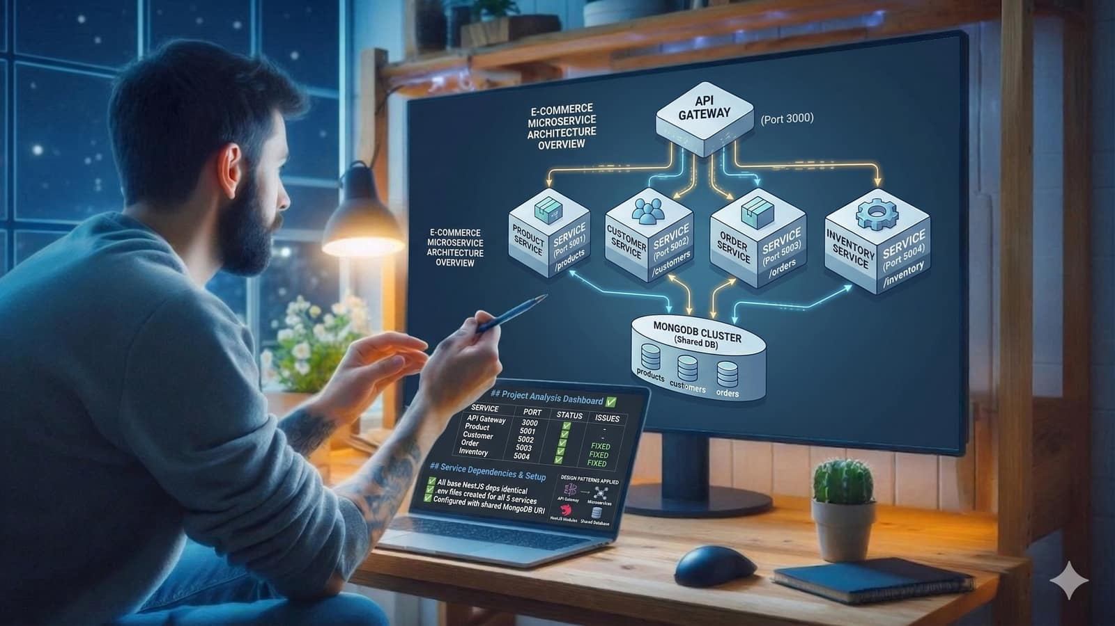


MTIT ASSIGNMENT 2 :IT 4020
GROUP NO: 254
SLIIT
FACULTY OF COMPUTING
31/03/2026

Slide 2





OUR TEAM
CLAUDIA ALVES
KAUSHAN
M.K.A
JAYAWEERA R.C
SUMANAWEERA
A. D. H. R
JAYAWEERA J.P.S.P
IT22215574
IT22283344
IT22569622
IT22277572
SLIIT
FACULTY OF COMPUTING
31/03/2026

Slide 3
TABLE OF CONTENT
Introduction to problem
Solution Overview
Technologies
Architecture Overview
API Gateway
Advantages of API Gateway
Folder Structure
Swagger Screenshots
Microservices Identified
DIrect vs testing via gateway
Conclusion
References
SLIIT
FACULTY OF COMPUTING
31/03/2026

Slide 4
INTRODUCTION TO PROBLEM
Traditional monolithic systems are hard to scale and maintain
Tight coupling between components
Difficult to update or deploy features independently
Large codebase becomes hard to maintain
Result:
Slow development, high downtime risk, poor scalability
SLIIT
FACULTY OF COMPUTING
31/03/2026

Slide 5

SOLUTION OVERVIEW
Microservices Architecture Approach:
Each microservice is independent, deployable, and scalable
Component | Role
4 Microservices | Each handles ONE business domain
API Gateway | Single entry point (port 3000)
SLIIT
FACULTY OF COMPUTING
31/03/2026

Slide 6




TECHNOLOGIES
NESTJS
MONGODB
SWAGGER
MONGOOSE
SLIIT
FACULTY OF COMPUTING
31/03/2026

Slide 7
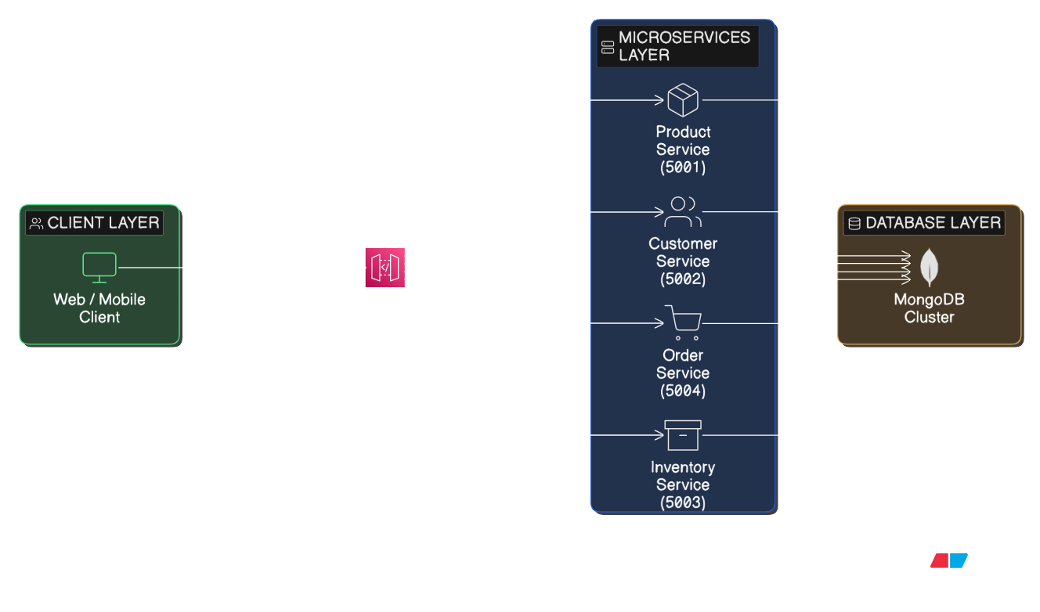
ARCHITECTURE OVERVIEW
SLIIT
FACULTY OF COMPUTING
31/03/2026

Slide 8

API GATEWAY
Without API Gateway
With API Gateway
Client
Client
Product ServiProduct Service (5001)
Customer Service (5002)
API Gateway→(3000)
Inventory Service (5003)
/products → Product Service (5001)
Order Service (5004)
/customers → Customer Service (5002)
/inventory → Inventory Service (5003)
/orders → Order Service (5004)
API Gateway hides multiple service ports and provides one centralized access point for the entire system and Client only needs one endpoint
SLIIT
FACULTY OF COMPUTING
31/03/2026

Slide 9
ADVANTAGES OF API GATEWAY
Advantage | Benefit in Our Implementation
Single Entry Point | Client uses ONE URL (port 3000) instead of 4
Service Abstraction | Services can move/change without client updates
Simplified Client | Frontend doesn't need to know service locations
SLIIT
FACULTY OF COMPUTING
31/03/2026

Slide 10
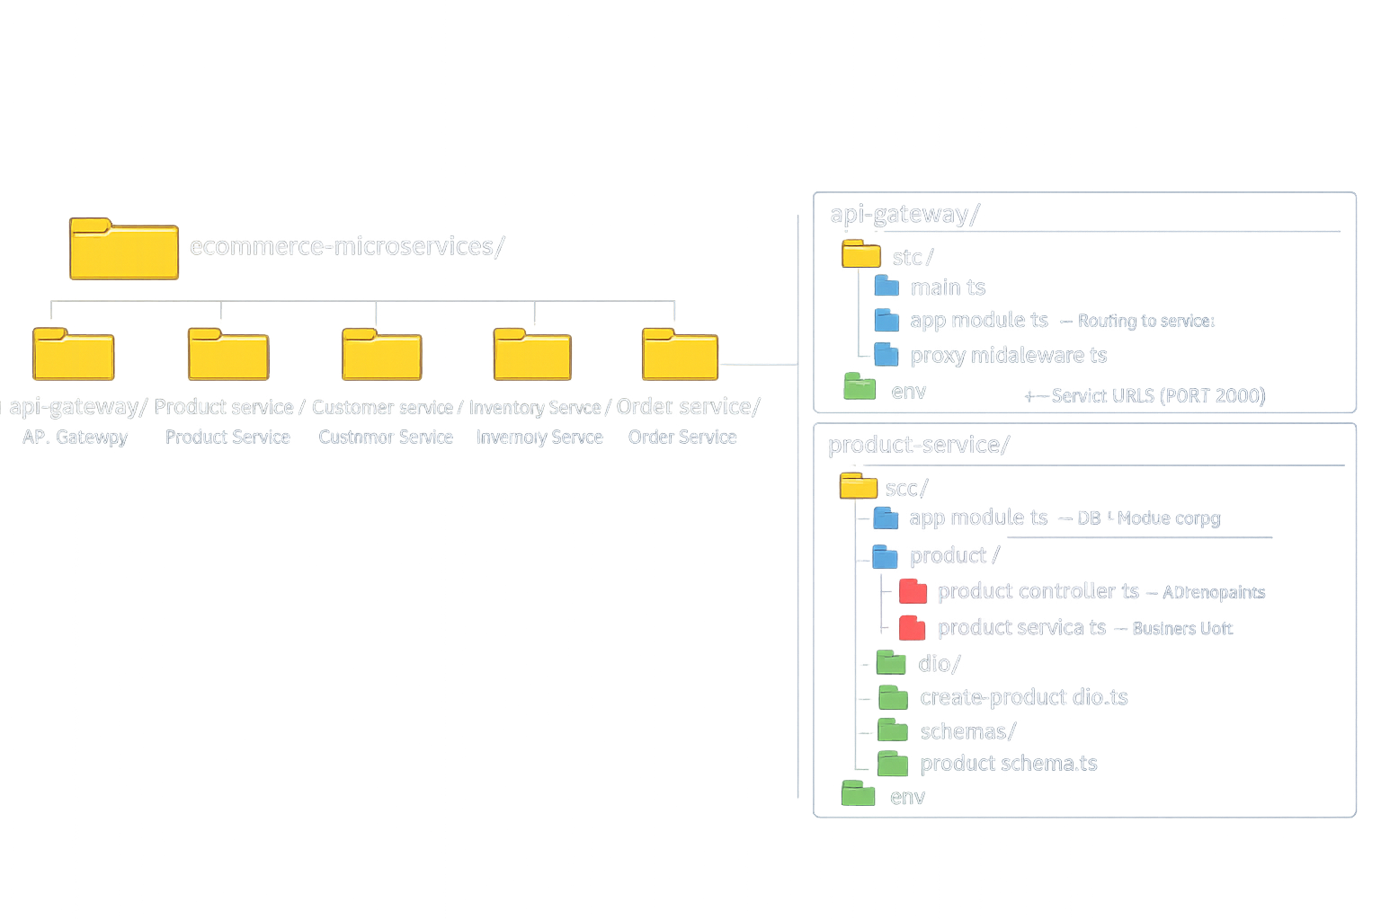
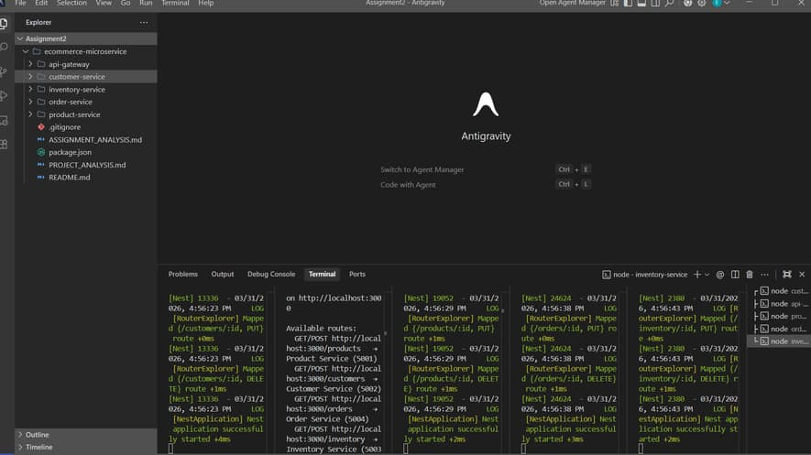
FOLDER STRUCTURE
SLIIT
FACULTY OF COMPUTING
31/03/2026

Slide 11
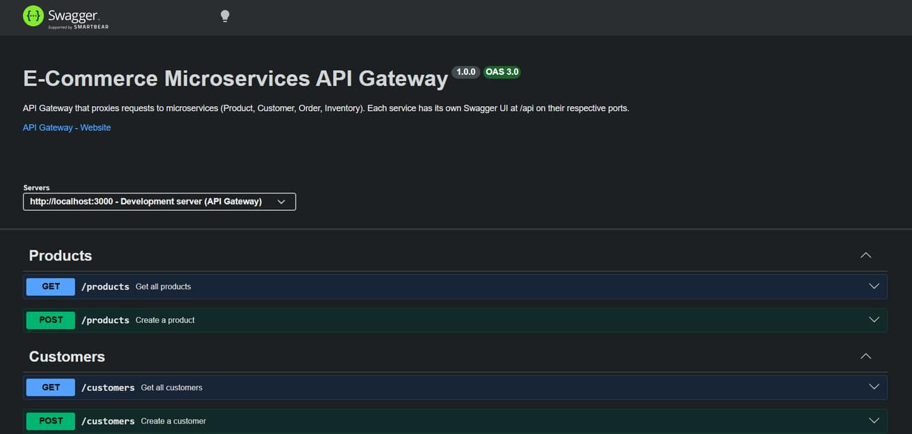
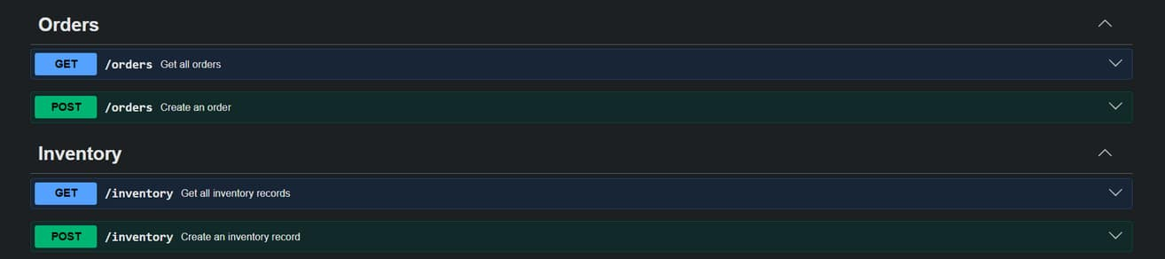
SWAGGER SCREENSHOTS
API
GATEWAY
SLIIT
FACULTY OF COMPUTING
31/03/2026

Slide 12
MICROSERVICES IDENTIFIED
Port | SERVICE | Owned By
5001 | Product Service | IT22283344
5002 | Customer Service | IT22569622
5003 | Inventory Service | IT22277572
5004 | Order Service | IT22569622
SLIIT
FACULTY OF COMPUTING
31/03/2026

Slide 13

CUSTOMER SERVICE
Implemented customer.controller.ts with CRUD endpoints
Designed CustomerSchema for MongoDB
Created CreateCustomerDto for input validation
Integrated Swagger documentation with @ApiOperation
Tested all endpoints via direct and gateway access
Responsibility:
Managing customer data including registration, update, and retrieval of customer information
IT22569622 - JAYAWEERA R.C
SLIIT
FACULTY OF COMPUTING
31/03/2026

Slide 14
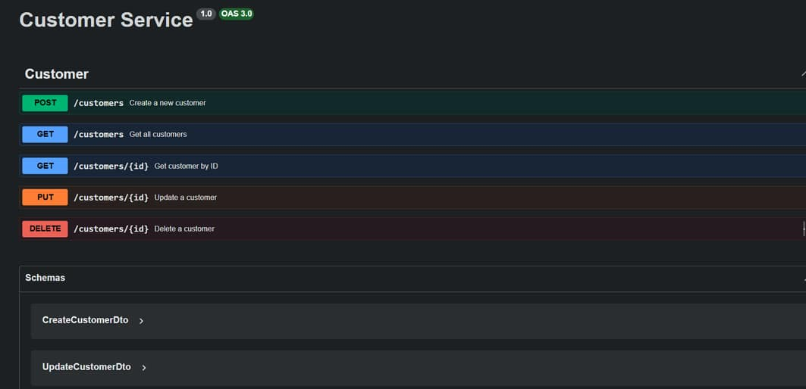
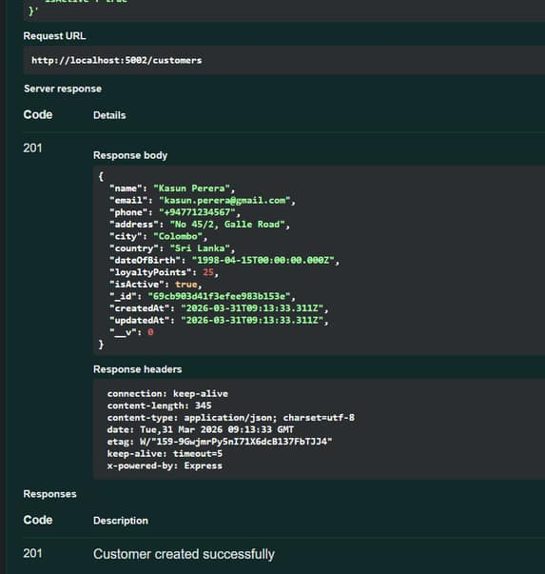
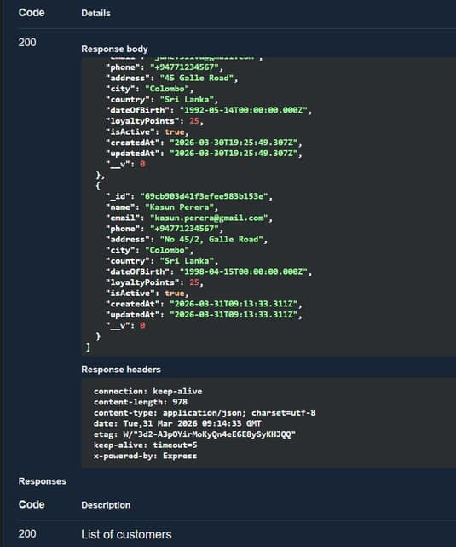
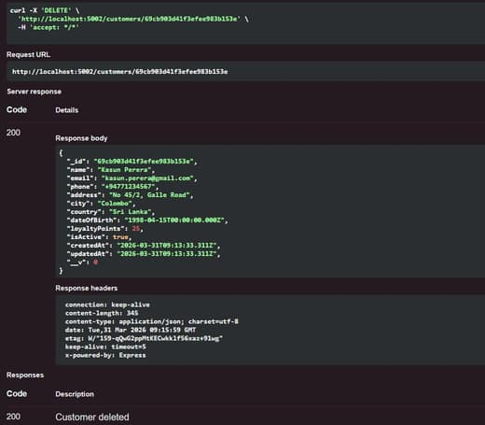
CUSTOMER SERVICE
IT22569622 - JAYAWEERA R.C
SLIIT
FACULTY OF COMPUTING
31/03/2026

Slide 15
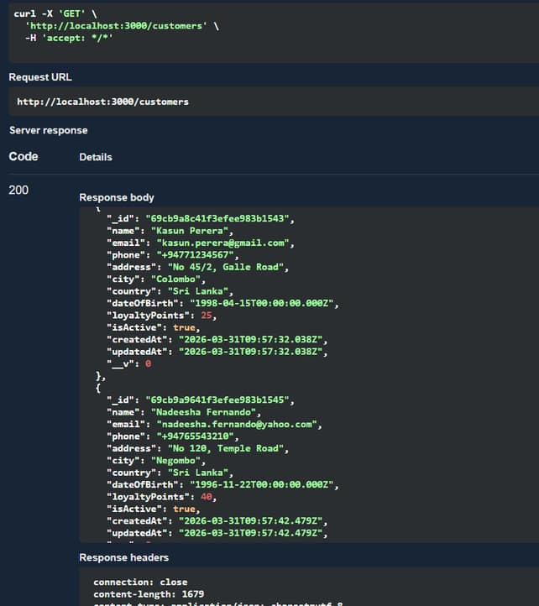
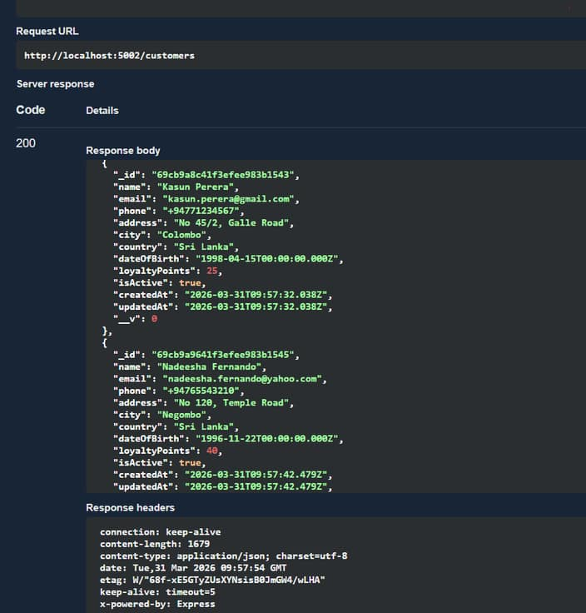
DIRECT VS TESTING VIA GATEWAY
Customer service
IT22569622 - Jayaweera R.C
SLIIT
FACULTY OF COMPUTING
31/03/2026

Slide 16

PRODUCT SERVICE
Implement product.controller.ts with CRUD endpoints
Designed ProductSchema for MongoDB
Created CreateProductDto for input validation
Integrated Swagger documentation with @ApiOperation
Tested all endpoints via direct and gateway access
Responsibility:
Managing product catalog including creation, update, deletion, and retrieval of product information
IT22283344 - SUMANAWEERA A. D. H. R
SLIIT
FACULTY OF COMPUTING
31/03/2026

Slide 17
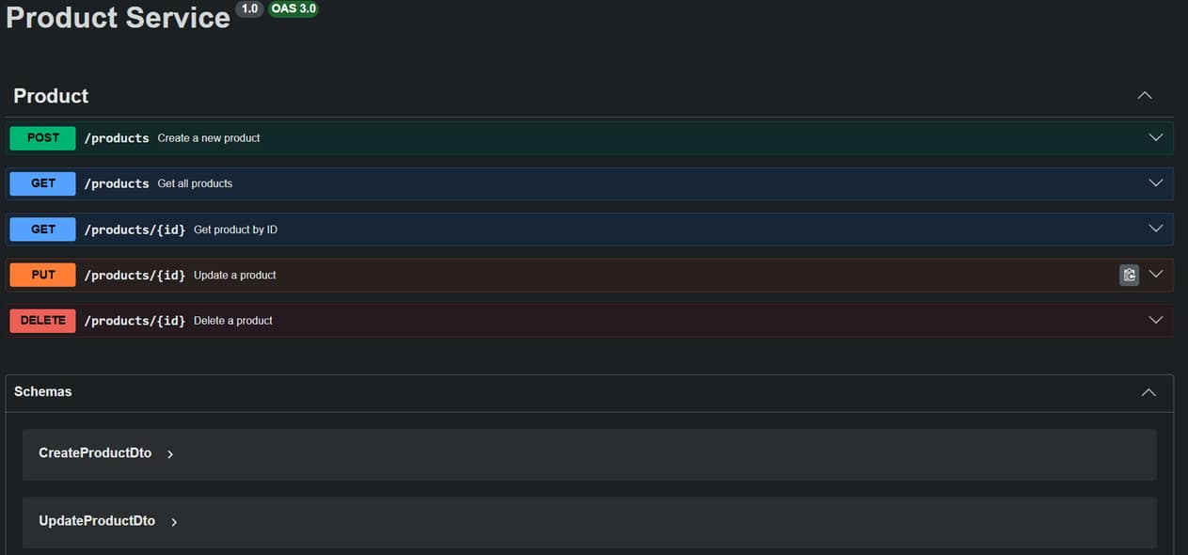
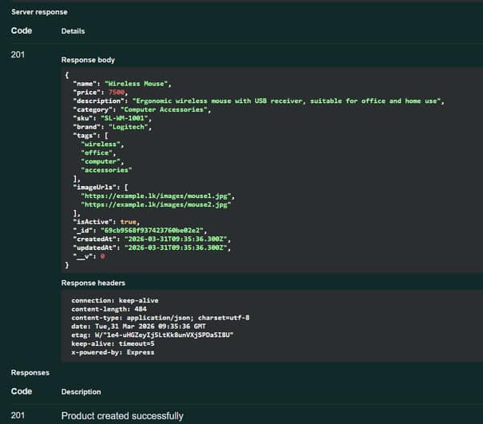
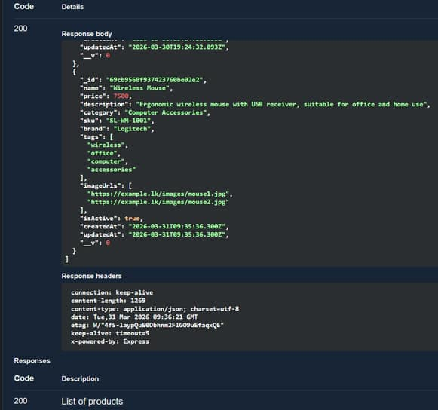
PRODUCT SERVICE
IT22283344 - SUMANAWEERA A. D. H. R
SLIIT
FACULTY OF COMPUTING
31/03/2026

Slide 18
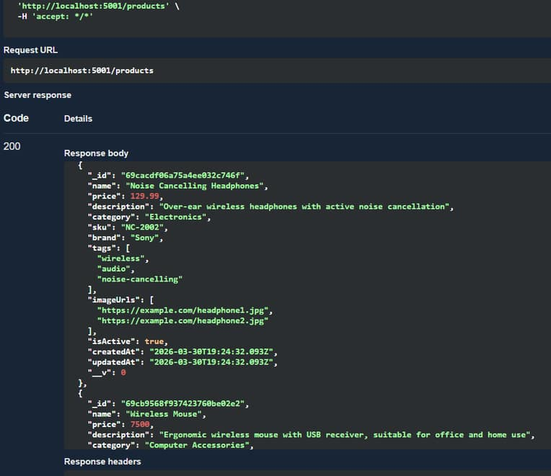
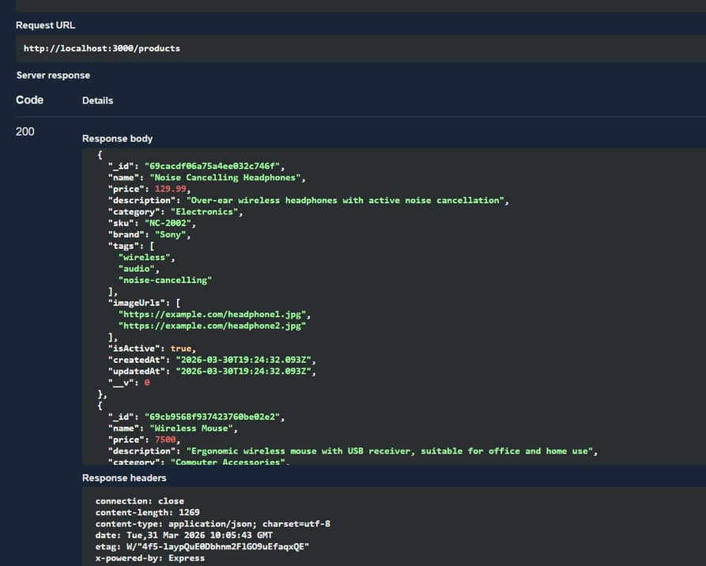
DIRECT VS TESTING VIA GATEWAY
Product service
IT22283344 - Sumanaweera A. D. H. R
SLIIT
FACULTY OF COMPUTING
31/03/2026

Slide 19

ORDER SERVICE
Implemented order.controller.ts with CRUD endpoints
Designed OrderSchema for MongoDB
Created CreateOrderDto for input validation
Integrated Swagger documentation with @ApiOperation
Tested all endpoints via direct and gateway access
Responsibility:
Managing order processing including creation, update, and retrieval of customer orders
IT22569622 - KAUSHAN M.K.A
SLIIT
FACULTY OF COMPUTING
31/03/2026

Slide 20
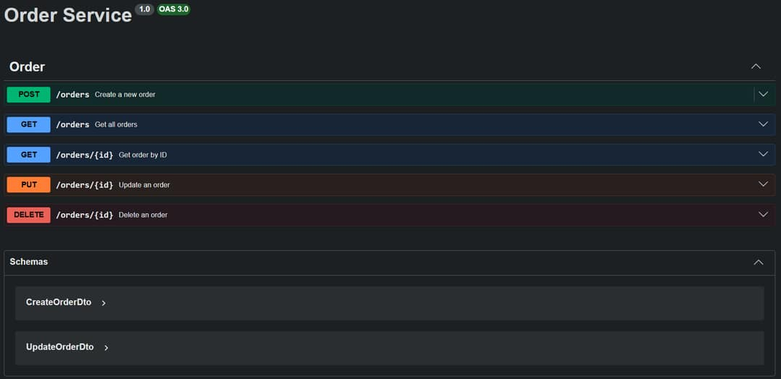
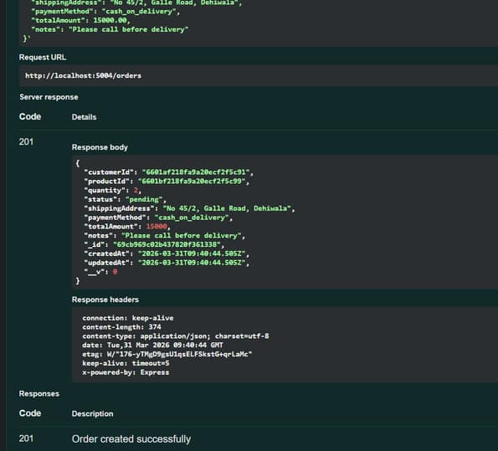
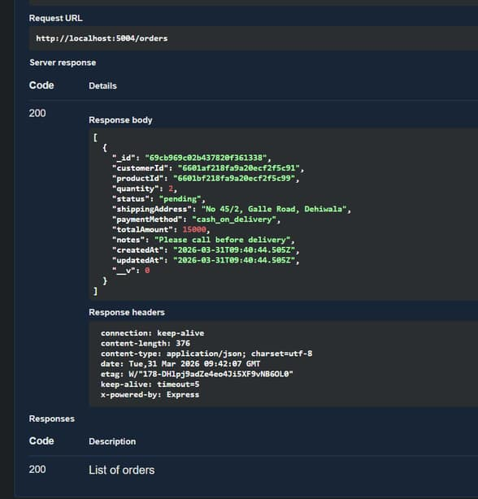
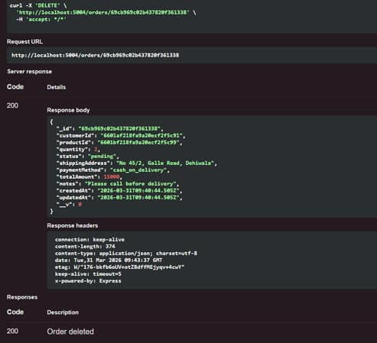
ORDER SERVICE
IT22569622 - KAUSHAN M.K.A
SLIIT
FACULTY OF COMPUTING
31/03/2026

Slide 21
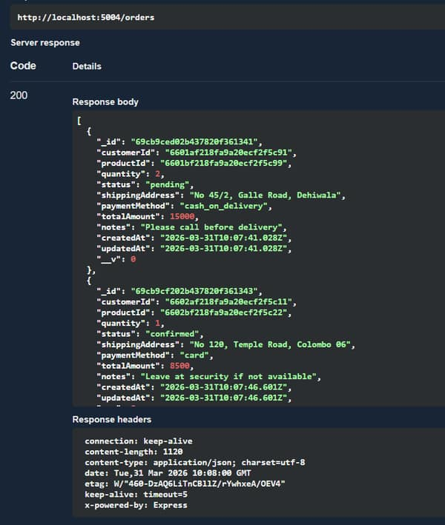
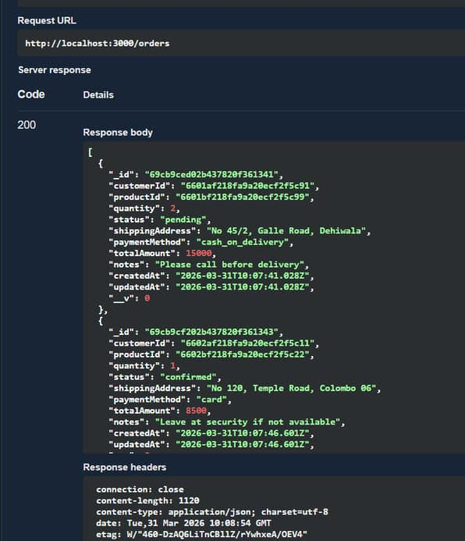
DIRECT VS TESTING VIA GATEWAY
Order service
IT22569622 - Kaushan M.k.a
SLIIT
FACULTY OF COMPUTING
31/03/2026

Slide 22

INVENTORY SERVICE
Implemented inventory.controller.ts with CRUD endpoints
Designed InventorySchema for MongoDB
Created CreateInventoryDto for input validation
Integrated Swagger documentation with @ApiOperation
Tested all endpoints via direct and gateway access
Responsibility:
Managing inventory including tracking product stock levels, updates, and availability
IT22277572 - JAYAWEERA J.P.S.P
SLIIT
FACULTY OF COMPUTING
31/03/2026

Slide 23
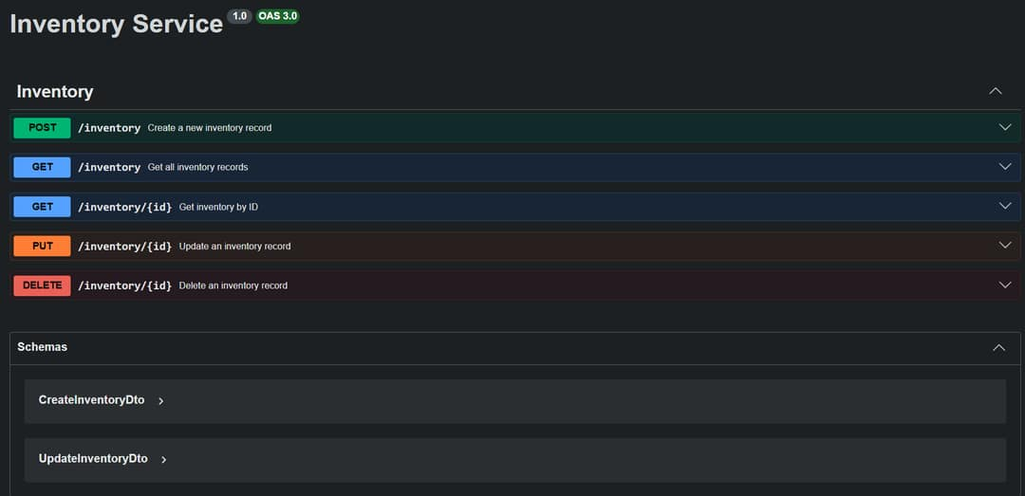
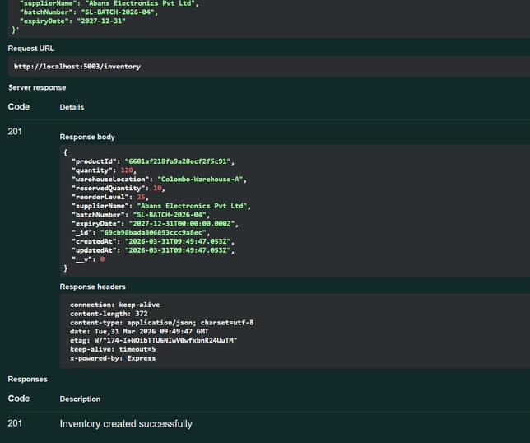
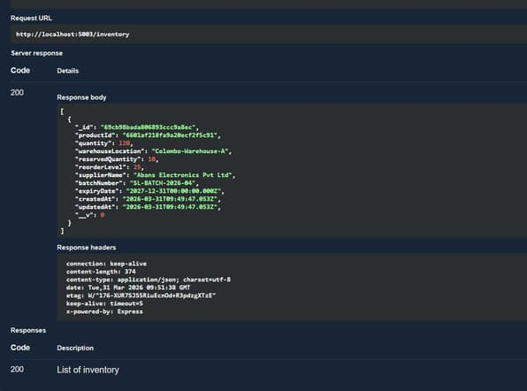
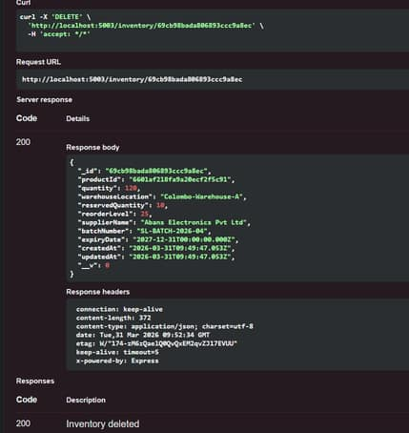
INVENTORY SERVICE
IT22277572 - JAYAWEERA J.P.S.P
SLIIT
FACULTY OF COMPUTING
31/03/2026

Slide 24
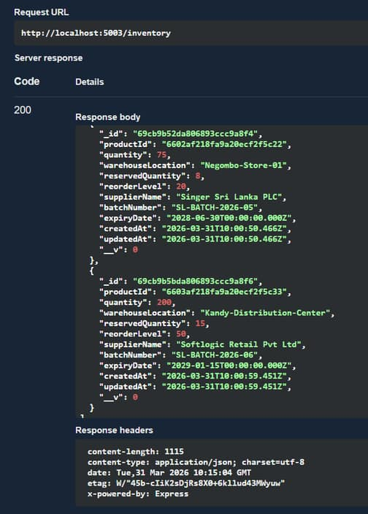
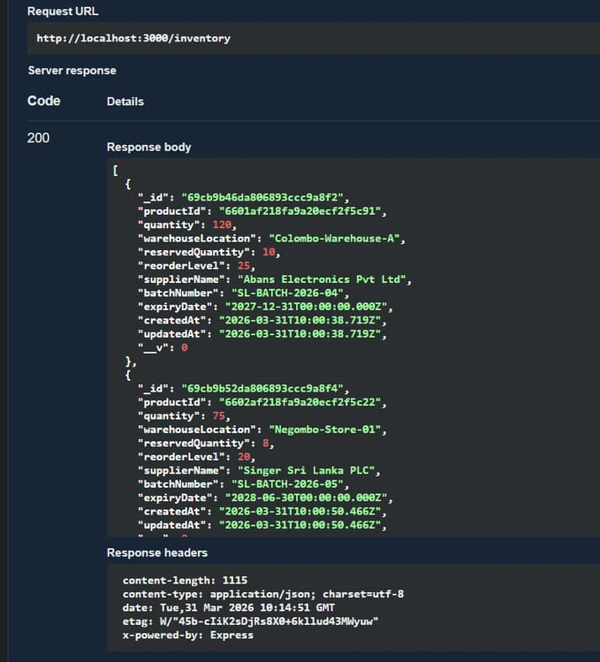
DIRECT VS TESTING VIA GATEWAY
Inventory service
IT22277572 - Jayaweera J.P.S.P
SLIIT
FACULTY OF COMPUTING
31/03/2026

Slide 25
CONCLUSION
What We Achieved:
4 independent microservices (Product, Customer, Inventory, Order)
API Gateway providing single entry point (port 3000)
Full CRUD operations on all services
Direct and gateway access both working
Key Learnings
API Gateway simplifies client communication
Microservices improve scalability and maintainability
SLIIT
FACULTY OF COMPUTING
31/03/2026

Slide 26
REFERENCES
[1] J. Lewis and M. Fowler, “Microservices: A Definition of This New Architectural Term,” Martin Fowler Blog, Mar. 2014.
[2] NestJS, “NestJS Documentation,” [Online]. Available: https://docs.nestjs.com/ [Accessed: Mar. 31, 2026].
[3] MongoDB Inc., “MongoDB Documentation,” [Online]. Available: https://www.mongodb.com/docs/ [Accessed: Mar. 31, 2026].
SLIIT
FACULTY OF COMPUTING
31/03/2026

Slide 27

THANK YOU.....
SLIIT
FACULTY OF COMPUTING
31/03/2026

